Slide 1

Controllers

Slide 2
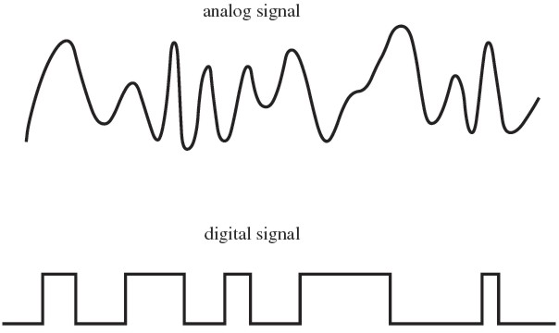
Analogue vs Digital Signals Reminder
For this lesson we are focusing on electrical signals which are split into two forms:
Analogue signals are continuous and change smoothly over time
Digital signals are discrete and therefore have set values which they change between

Slide 3
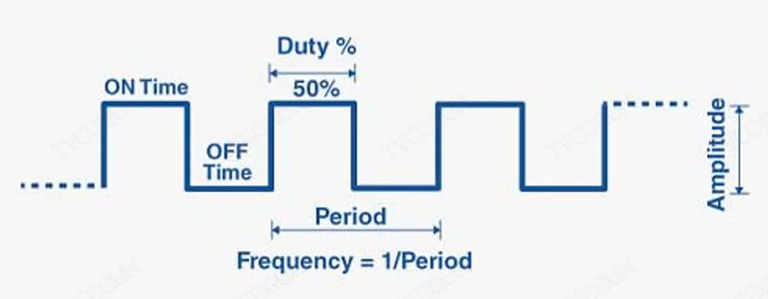
PWM Reminder
A technique to control power by rapidly switching a signal between ON and OFF states.
Simulates an analogue output using a digital signal
Used for controlling motors, LEDs, and power regulation

Slide 4
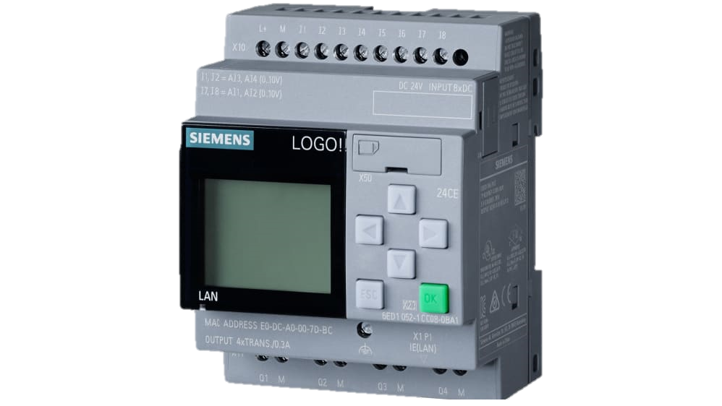
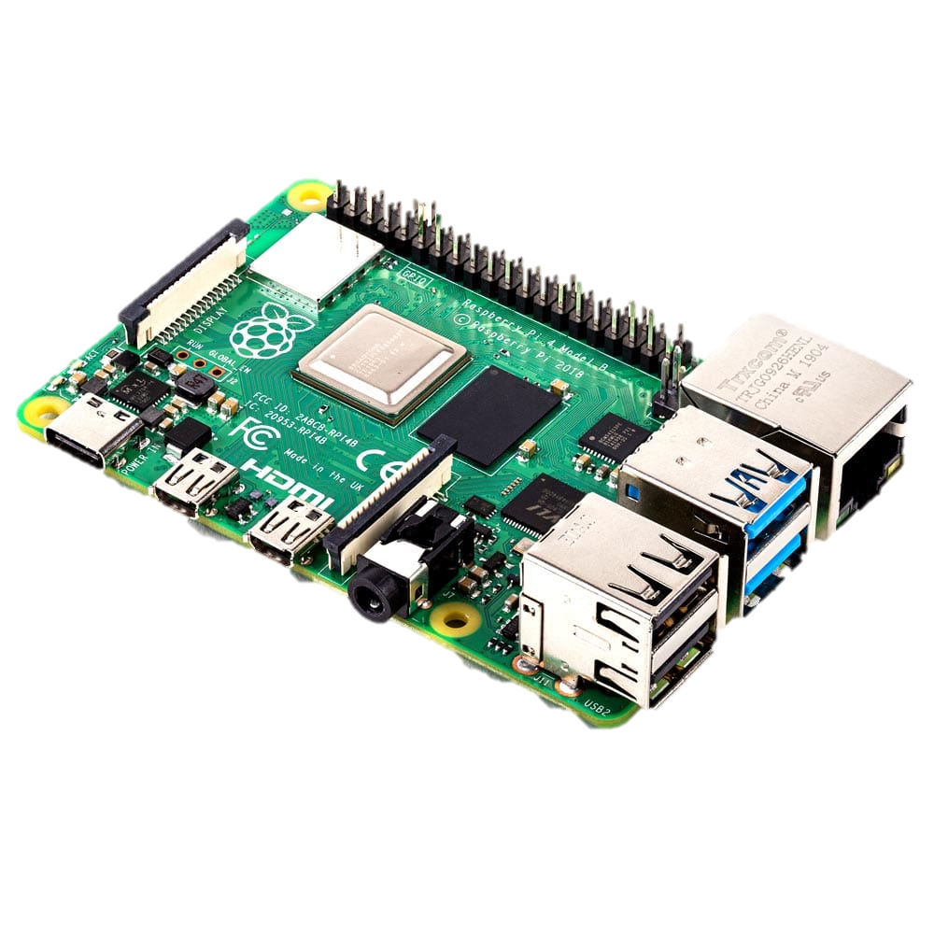
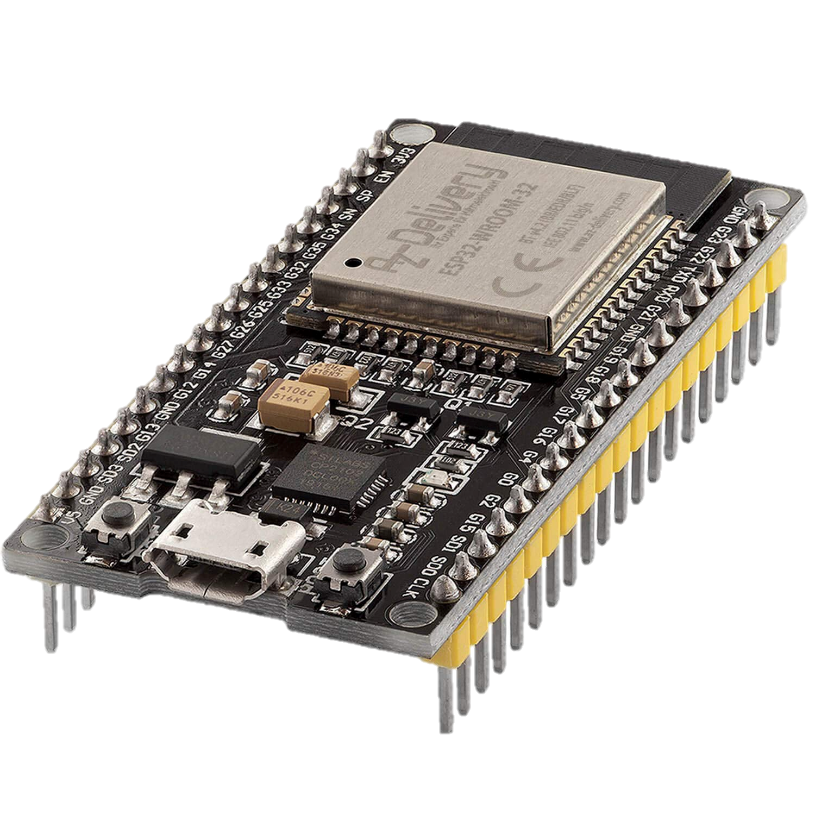
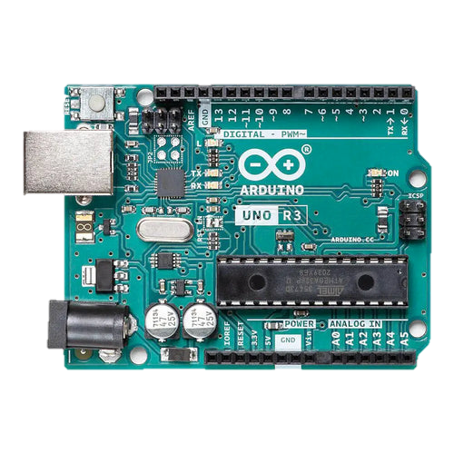
What are controllers?
Controllers are objects that link to sensors and actuators
They facilitate communication between sensors and actuators
They allow us to perform calculations with sensor inputs

Slide 5
What are microcontrollers?
Microcontrollers are small computers that act as controllers
They differ from most regular computers as they are optimised for a specific task
They often have lots of I/O (input/output) ports for communicating with lots of sensors and actuators

Slide 6
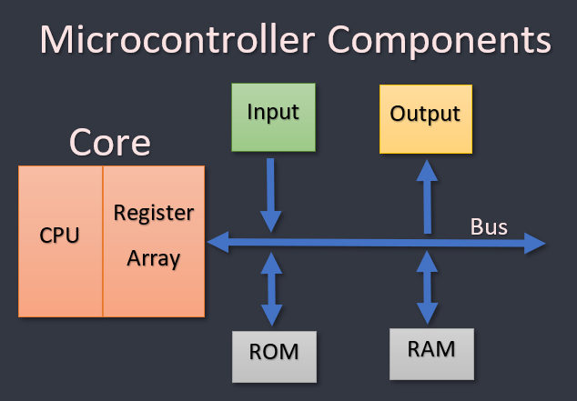
Components of a microcontroller
Micro controllers are made of the following key components:
Central Processing Unit (CPU):
The brain of the microcontroller
Processes instructions and controls everything
Memory:
ROM (Read-Only Memory): Stores the program/code permanently.
RAM (Random Access Memory): Temporary memory for running tasks.
I/O Pins:
Connects to the actuators and sensors

Slide 7
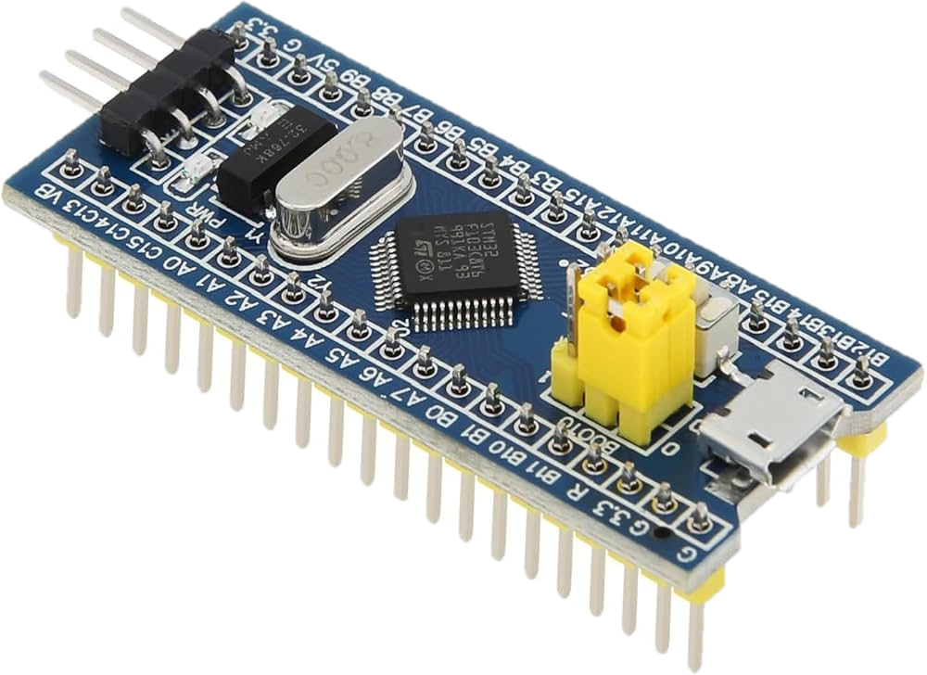
Most Common Microcontrollers
ATmega328P (Arduino Uno) – the most used microcontroller by both hobbyists and industry
ESP32 – much more powerful than the ATmega328P includes built in Wi-Fi and Bluetooth capabilities
STM32 – Used a lot for industrial and high-performance applications

Slide 8
Picking a microcontroller
Microcontroller (price) | Clock Speed | Memory | Bit Size | GPIO Pins | Wifi/Bluetooth built-in | Power Usage | Use cases | Usability
ATmega328P (£22-£25) | 16MHz | 32KB Flash 2KB RAM | 8-bit | 23 | No | Low Power (15 mA) | Low power or battery powered | Easiest
ESP32 (£7-£9) | Up to 240MHz | 4MB Flash 520KB RAM | 32-bit | 34+ | Yes | Higher Power (160 mA) | Anything that needs wireless | Moderate
STM32 (£30-£35) | Up to 72MHz | 64-512KB Flash 20KB RAM | 32-bit | 37+ | No | Middle Power (30-100mA) | Industrial control | Difficult

Slide 9
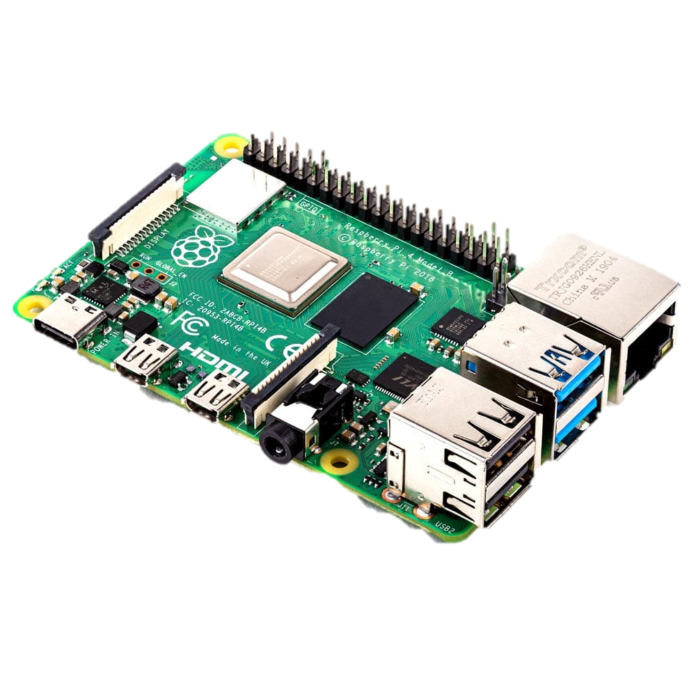
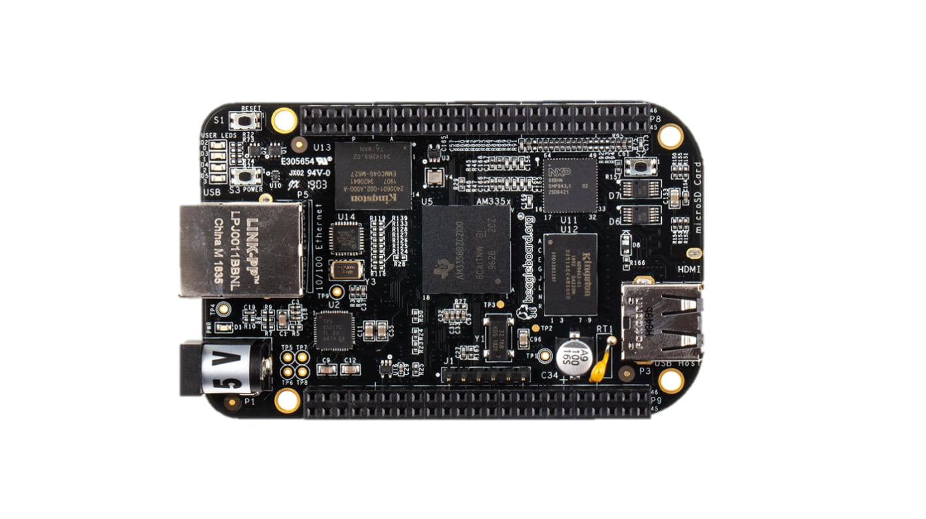
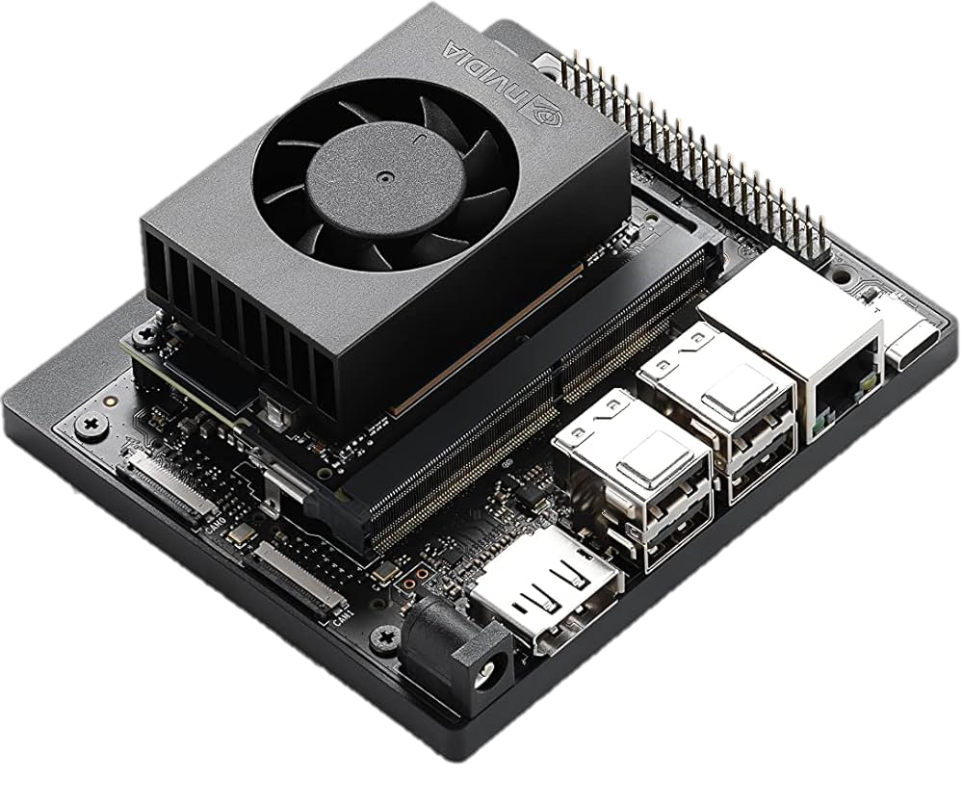
MicroComputers
Microcomputers are miniaturised computers that are used for specific tasks
They have a full OS allowing us to do much more complex tasks
Most common are Raspberry Pi Series, BeagleBone Series and Jetson Nano
They have higher power requirements than microcontrollers

Slide 10
Picking a MicroComputer
Microcontroller | Price | Power Consumption | Processing Power | GPIO Pins | Best for
Raspberry pi 4/5 | £50-£100 | Most Power Hungry | Medium Power | 40 Pins | General purpose, all rounder
BeagleBone Black | £50-70 | Least Power Hungry | Least Powerful | 69 Pins | Industrial Control, Automation, Robotics
Jetson Nano | £80-£120 | Medium Power Hungry | Most Powerful | 40 Pins | AI, Machine Learning, Computer Vision

Slide 11
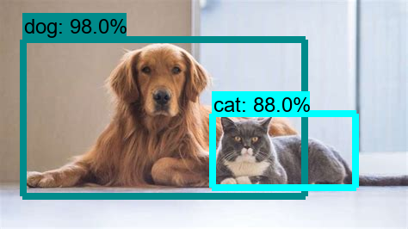
Microcontroller vs Microcomputers
We need a microcomputer when we are doing anything which needs significant processing power
For instance, if we wanted to detect an animal on a video feed, we would need a microcomputer as microcontrollers are not powerful enough

